Slide 1

Welcome to CVAI
Computer Vision and Artificial Intelligence fundamentals course
Created by Andrés Santiago Martínez Hernández

Slide 2
Today’s lesson: Introduction to contemporary AI
Summary of the Course and methodology
What is (and isn’t) AI
The classification, detection, and segmentation paradigm
Generative and discriminative models
Applications of AI in robotics
1

Slide 3



Computer Vision and Artificial Intelligence Fundamentals
General objective:
A series of workshops to teach the elemental theorems behind discriminative and generative models, ML, DL, and the SoA for CV
Methodology:
Theory Session
Practical Session
Hands on Work Session
Learn about the theorems behind the technologies of interest
Consolidate knowledge through a guided workshop
Go beyond and create an advanced version of the practical session with a special task
1

Slide 4
Summary
Introduction to contemporary AI
The detection and classification problems
Principles of Visual Recognition
The segmentation problem
Advanced Neural Networks
Transfer learning and Tiny ML
Further Steps
P1
P2
Projects:
Applications that would be used on an actual Rover, drone, or submarine; they are built within the course and work as a knowledge filter.
2

Slide 5


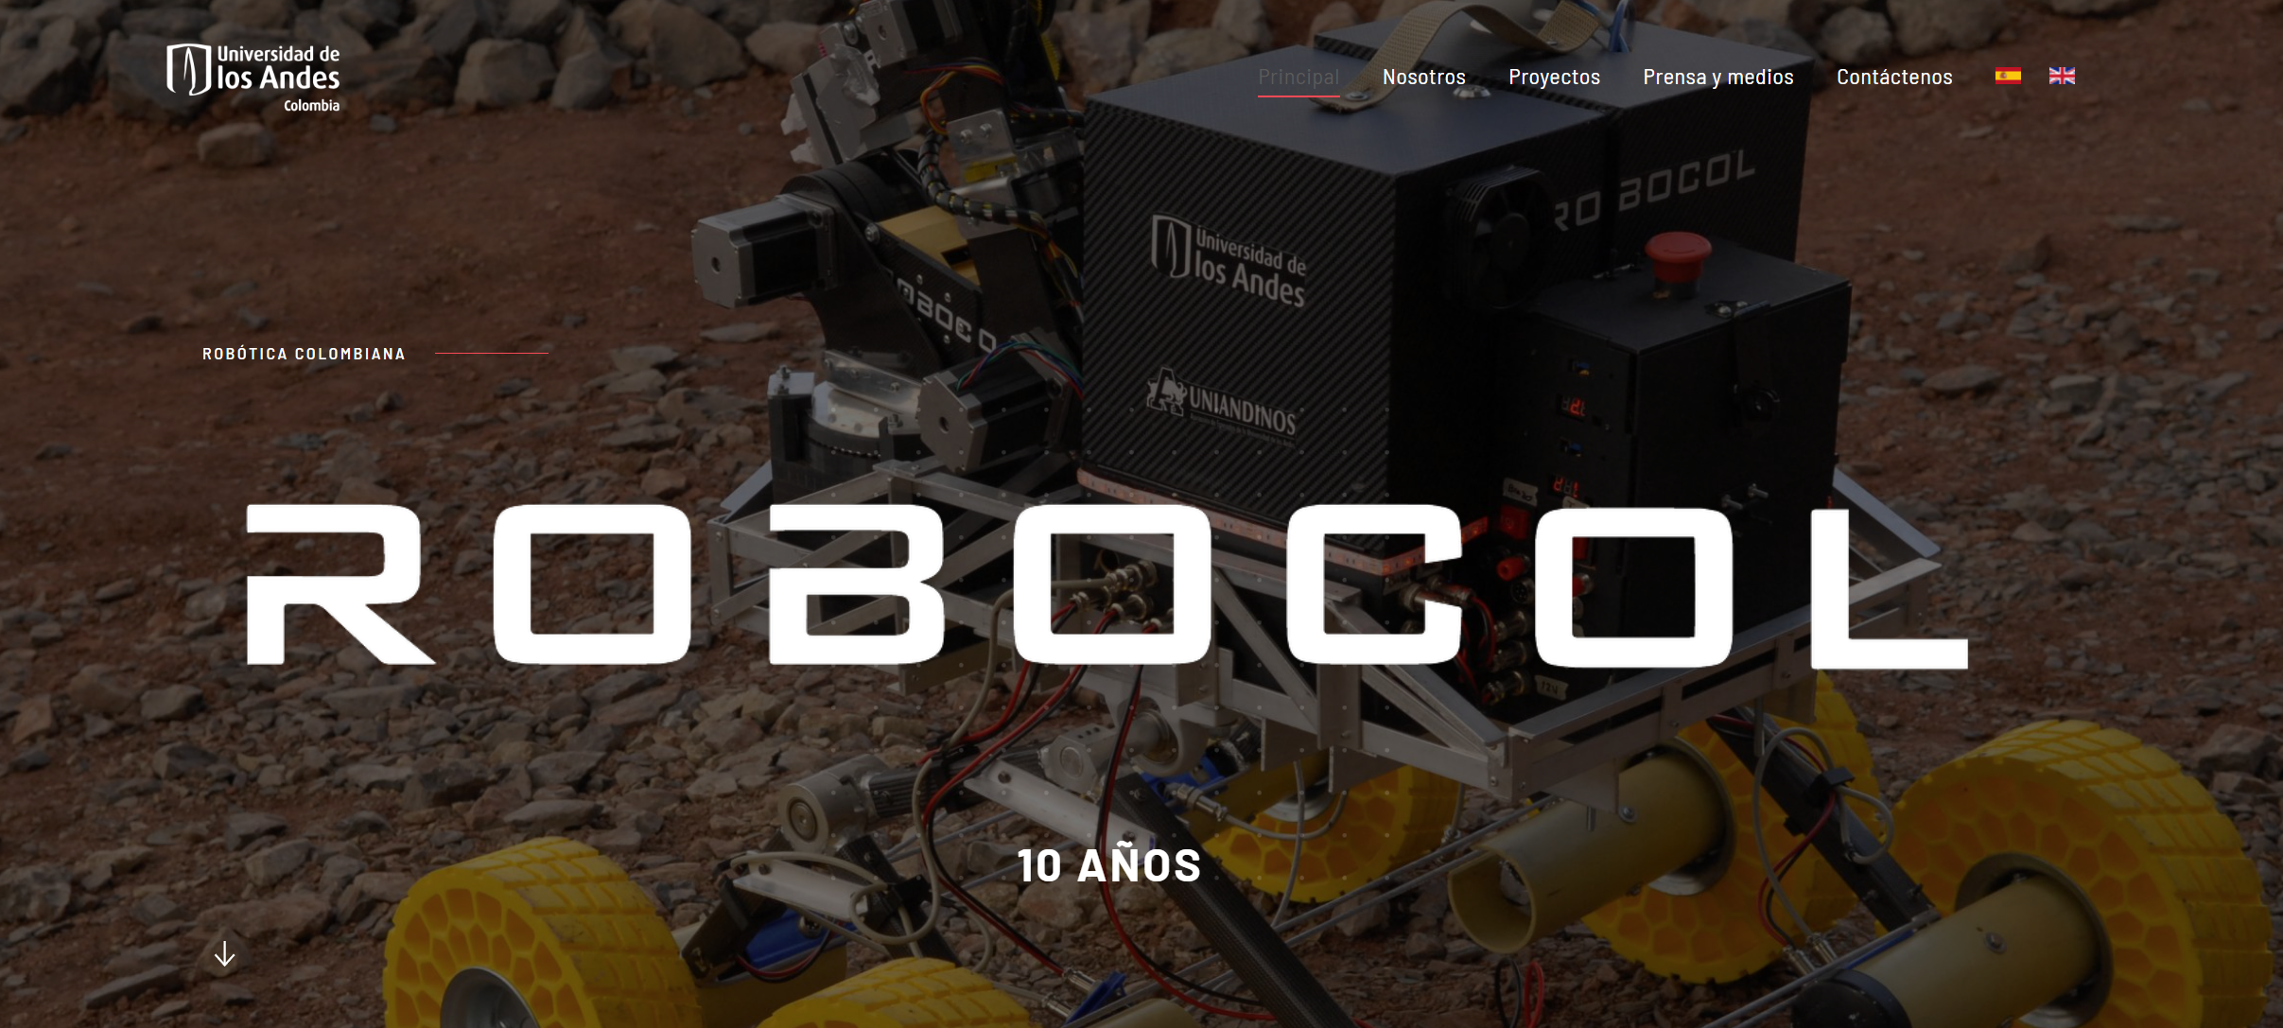
Some final chit-chat
3

Slide 6
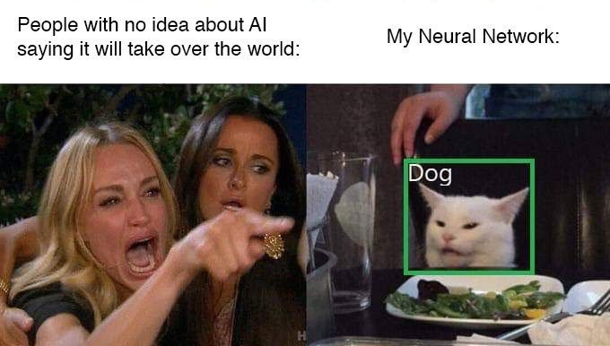
Introduction to contemporary AI
https://twitter.com/abhi1thakur/status/1512742609126576132
Where are we? (Technologically speaking)
4

Slide 7
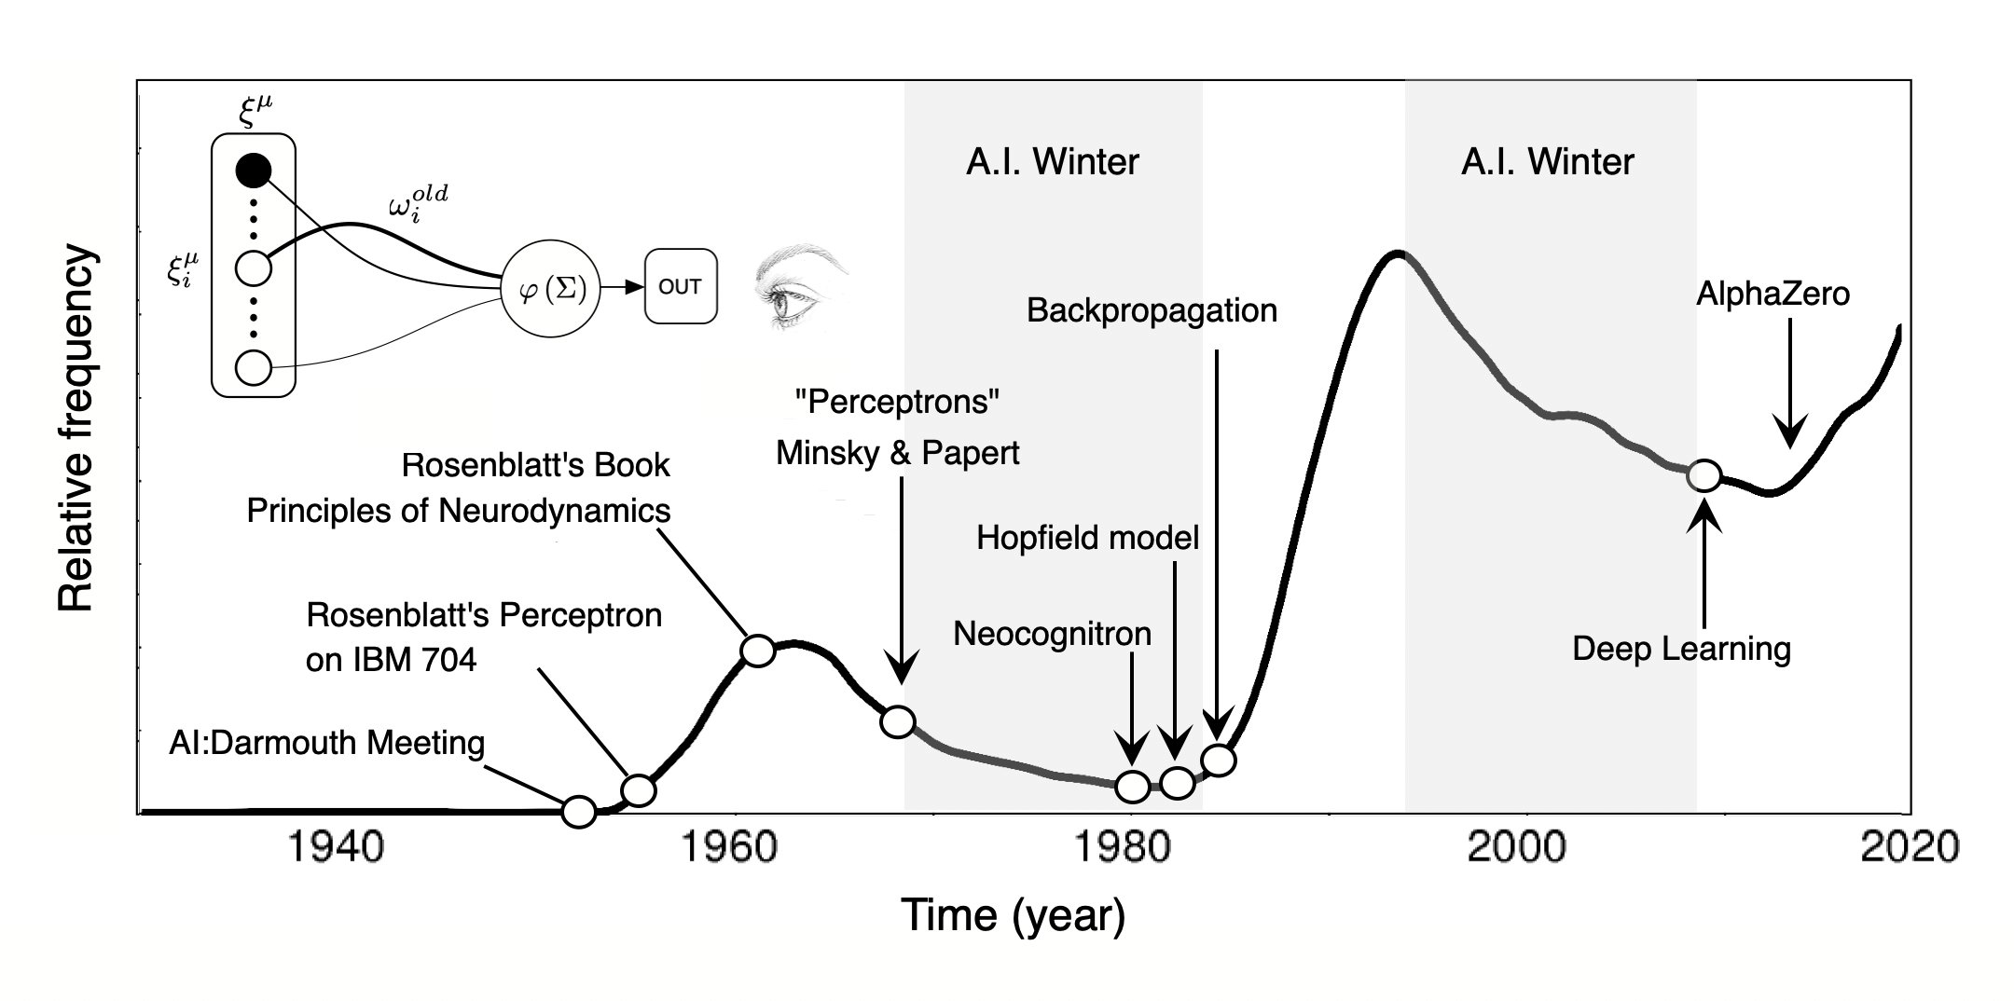
AI is quite old
The Gen AI Breakthrough
Expert Systems (2nd Boom)
Machine Learning (3rd Boom)
GOFAI (1st Boom)
Incremental progress
3rd AI Winter
https://twitter.com/ricard_sole/status/1497306702181548039
The Turing test is proposed
Limited applicability
Expensive, inflexible, inefficient
Data driven: Cheap and flexible processing ML, DL
Heuristic Search, “General Problem Solver”
Knowledge-> Inference! (MYCIN, AARON)
5

Slide 8
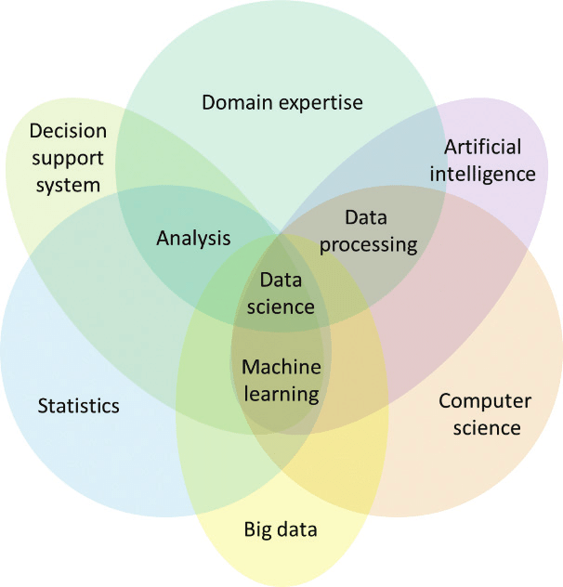
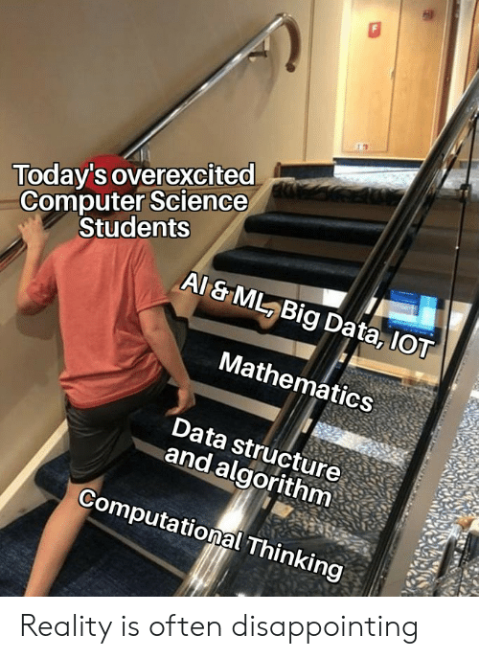
What is AI, and what isn’t?
DOI:10.5772/intechopen.81872
https://towardsdatascience.com/math-for-machine-learning-motivation-25ebbbebff09
6

Slide 9
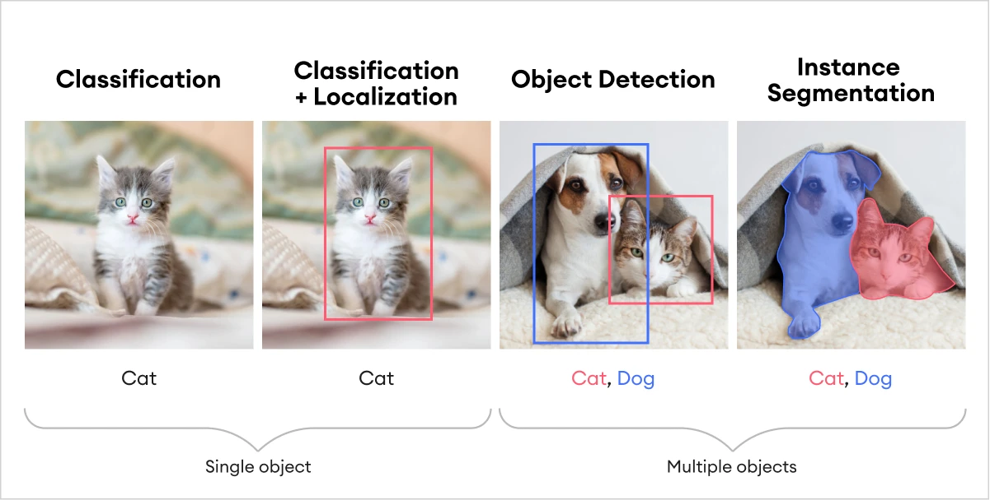
Let’s talk about the computer vision big three
Classification
Is this a cat?
Detection
What and where is something
Segmentation
Which pixels belong to which object
https://www.oreilly.com/library/view/deep-learning-for/9781788295628/4fe36c40-7612-44b8-8846-43c0c4e64157.xhtml
7

Slide 10
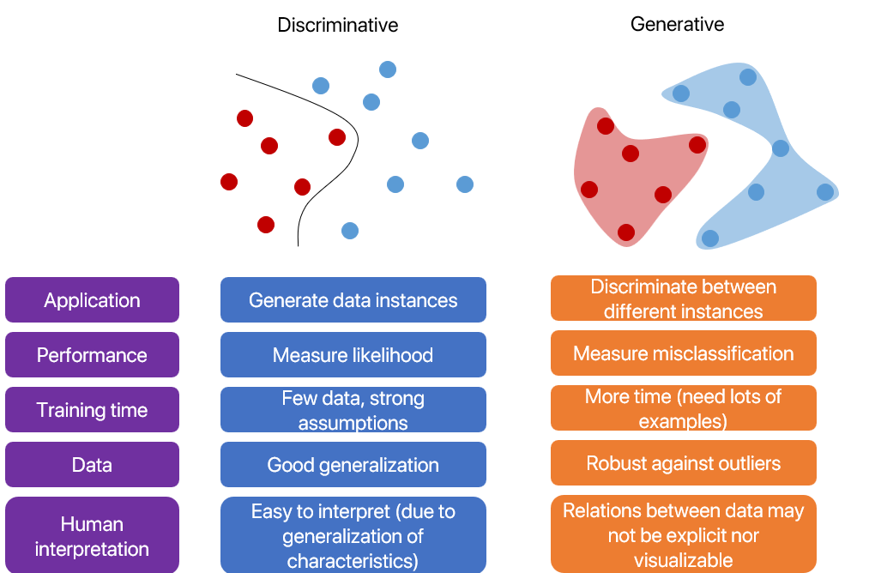
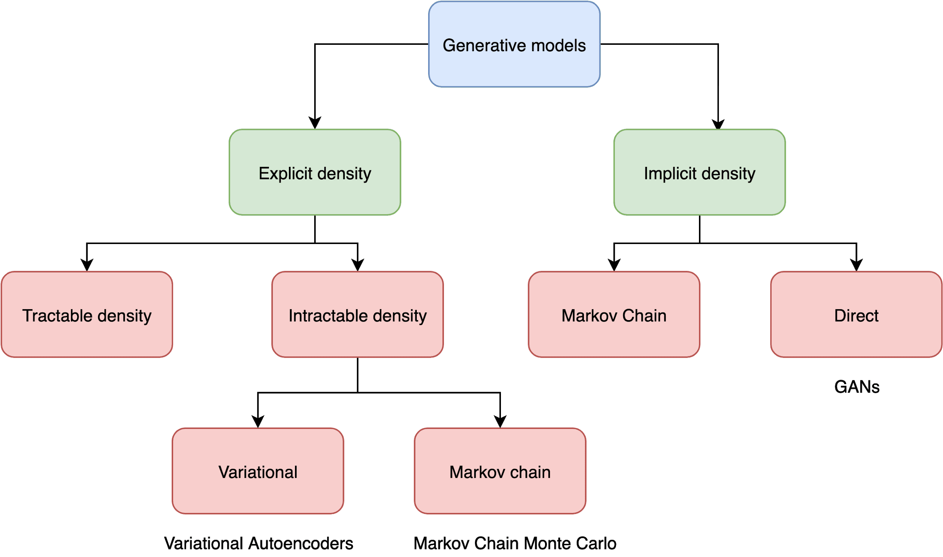
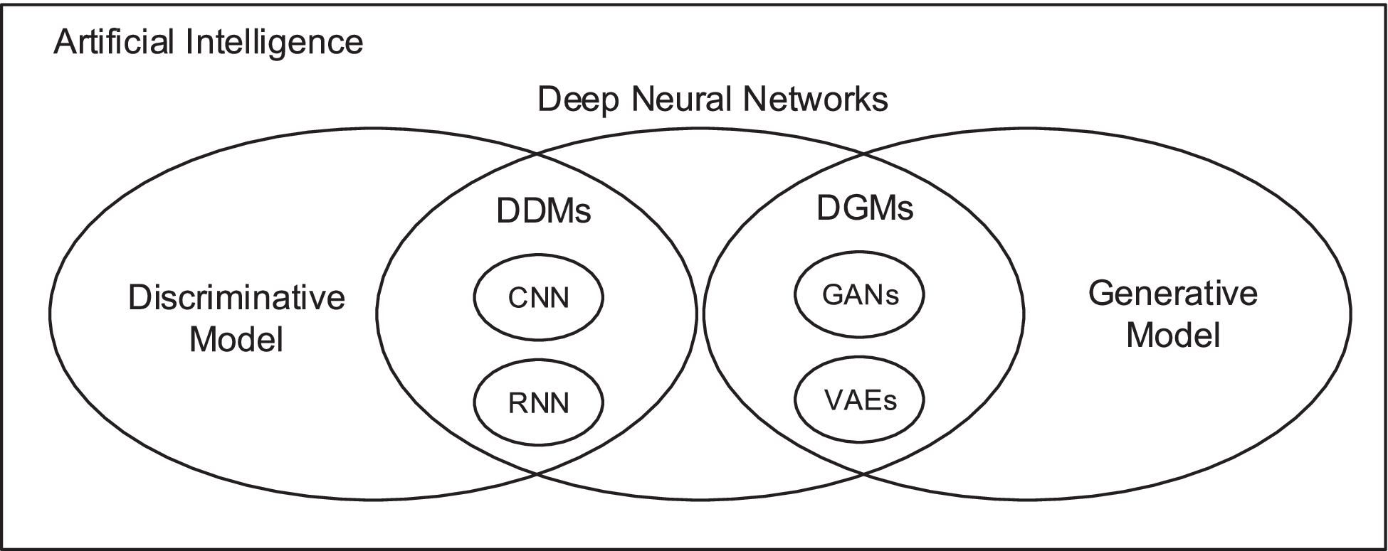
Discriminative, generative, everything
https://glsadz.com/w2Dfdhp1q5OYCck6dLSo-OWXAbYIOUhBQv0GyDohm-0/?cid=651b1d77d25a00000129fe89&sid=18754866
https://www.computer.org/csdl/journal/tk/2023/04/09627776/1yQwC3JN8ac
8

Slide 11

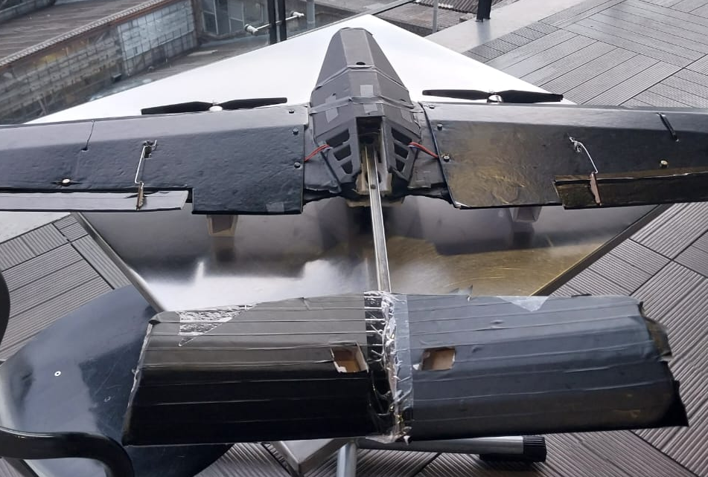
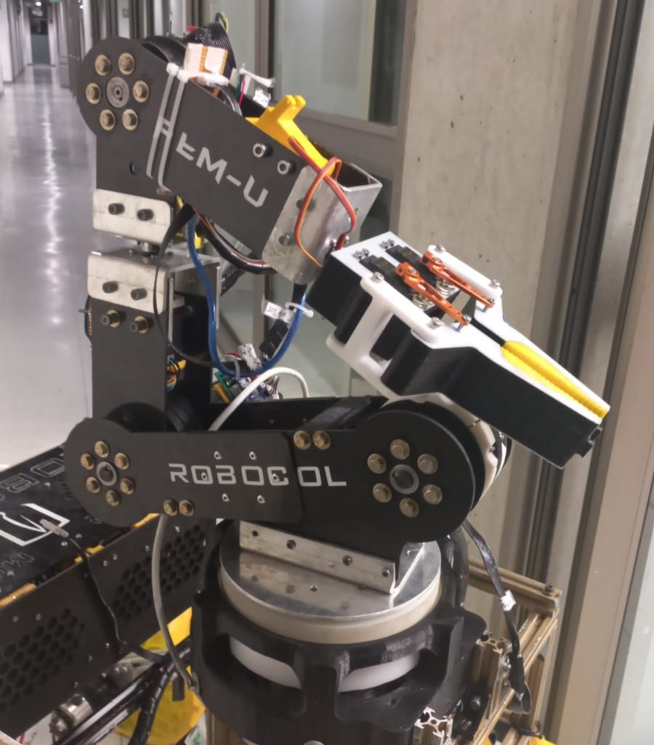
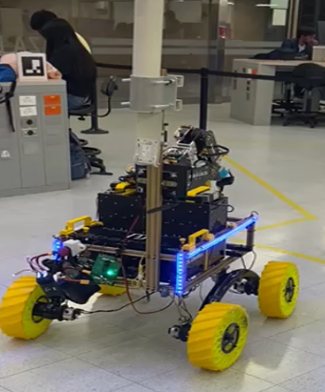
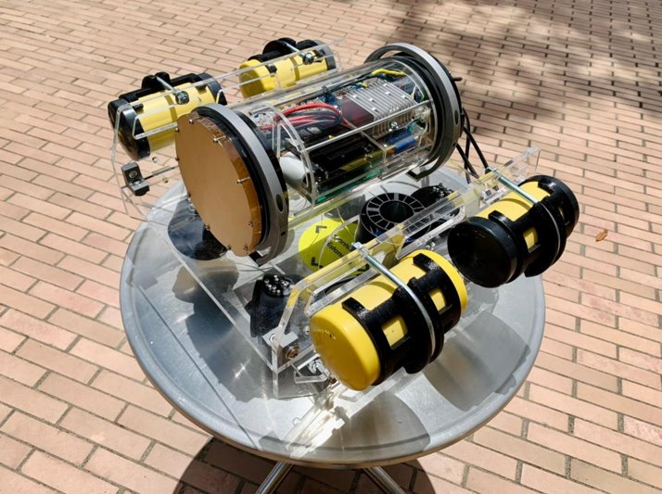
Our playground: CV on four different robots
Robocol robotics student initiative will kindly offer their 4 robots for our algorithms test drives. A submarine, a drone, a robotic arm, and a mars rover Each of them have a Raspberry Pi 4 of 8 GB RAM and at least a web camera
Each robot has a set of tasks according to the URC, ERC, and MateRov competitions.
Which one do you want to work on?
7

